Slide 1
18
Class string and
String Stream
Processing

Slide 2
The difference between the almost-right word and the right word is really a large matter — it's the difference between the lightning bug and the lightning.
  Mark Twain
I have made this letter longer than usual, because I lack the time to make it short.
  Blaise Pascal
Mum's the word.
  Miguel de Cervantes
Suit the action to the word, the word to the action; with this special observance, that you o'erstep not the modesty of nature.
  William Shakespeare

Slide 3
OBJECTIVES
In this chapter you’ll learn:
To use class string from the C++ Standard Library to treat strings as full-fledged objects.
To assign, concatenate, compare, search and swap strings.
To determine string characteristics.
To find, replace and insert characters in a string.
To convert strings to C-style strings and vice versa.
To use string iterators.
To perform input from and output to strings in memory.

Slide 4
18.1 Introduction
18.2 string Assignment and Concatenation
18.3 Comparing strings
18.4 Substrings
18.5 Swapping strings
18.6 string Characteristics
18.7 Finding Strings and Characters in a string
18.8 Replacing Characters in a string
18.9 Inserting Characters into a string
18.10 Conversion to C-Style char * Strings
18.11 Iterators
18.12 String Stream Processing
18.13 Wrap-Up

Slide 5
18.1 Introduction
C++ class template basic_string
  Provides typical string-manipulation operations
  Defined in namespace std
  typedefs
    For char
      typedef basic_string< char > string;
    Also provides one for wchar_t

Slide 6
18.1 Introduction (Cont.)
string object
  Initialization
    string empty();
      Creates an empty string containing no characters
    string text( "hello" );
      Creates a string containing the characters "hello"
    string name( 8, 'x' );
      Creates a string containing eight 'x' characters
    string month = "March";
      Implicitly performs string month( "March" );

Slide 7
18.1 Introduction (Cont.)
string object (Cont.)
  No conversion from int or char in a string definition
    Examples (produce syntax errors)
      string error1 = 'c';
      string error2( 'u' );
      string error3 = 22;
      string error4( 8 );
  Assigning a single character to a string object is allowed
    Example
      string1 = 'n';

Slide 8
Common Programming Error 18.1
Attempting to convert an int or char to a string via an initialization in a declaration or via a constructor argument is a compilation error.

Slide 9
18.1 Introduction (Cont.)
string object (Cont.)
  Member functions length and size
    Return the length of the string
  The subscript operator []
    Used to access and modify individual characters
    First subscript is 0, last subscript is length() – 1

Slide 10
18.1 Introduction (Cont.)
string object (Cont.)
  Stream extraction operator (>>)
    Example
      cin >> stringObject;
    Input is delimited by white-space characters
  Function getline is overloaded for strings
    Example
      getline( cin, string1 );
    Input is delimited by a newline ('\n');

Slide 11
18.2 string Assignment and Concatenation
Member function assign
  Copies the contents of a string into another string
  Single-argument version
    Copies contents of the string argument into the current string
  Three-argument version
    Copies a specified range of characters
    Example
      targetString.assign( sourceString, start, numberOfCharacters );

Slide 12
18.2 string Assignment and Concatenation (Cont.)
Member function at
  Allows access to individual characters
    Much like the subscript operator does
  Provides checked access (or range checking)
    Going past the end of the string throws an out_of_range exception
    Subscript operator does not provide checked access

Slide 13
18.2 string Assignment and Concatenation (Cont.)
string concatenation
  Addition operator and addition assignment operator
    Overloaded for string concatenation
  Member function append
    Single-argument version
      Concatenates contents of the string argument to end of the current string
    Three-argument version
      Concatenates specified range of characters from the string argument to end of the current string

Slide 14
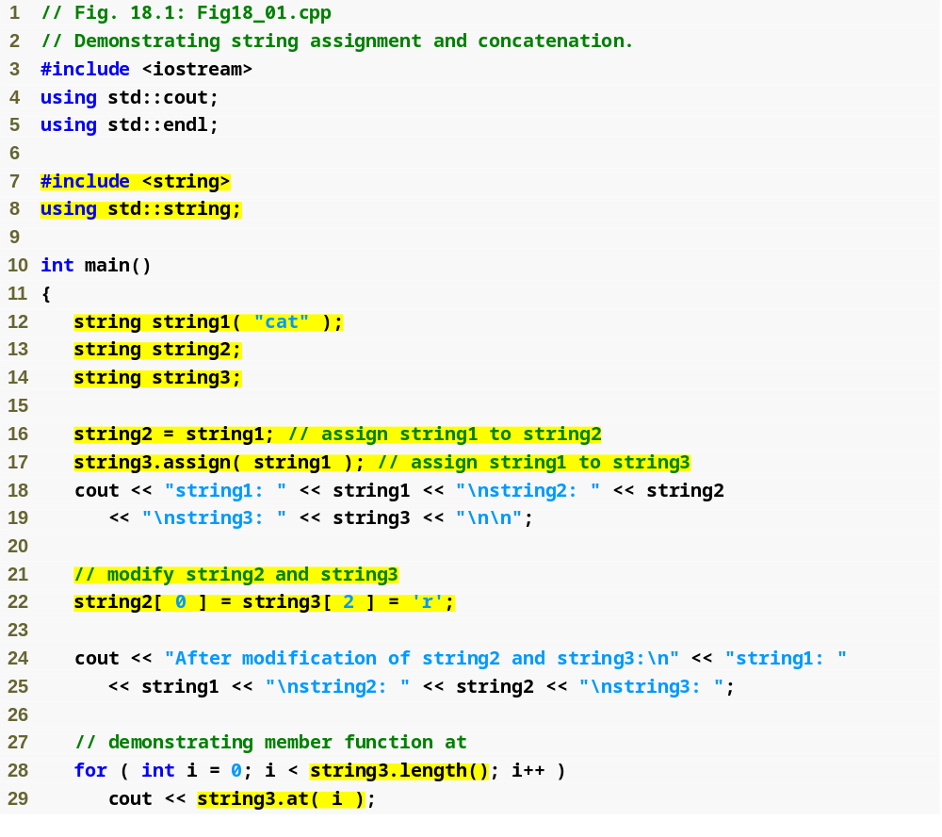
Outline
Fig18_01.cpp
(1 of 3)
Assign the value of string1 to string2 with the assignment operator
Copy string1 into string3 with the assign member function
Use the subscript operator to assign to individual characters
Use member functions length and at to output the contents of string3 one character at a time

Slide 15
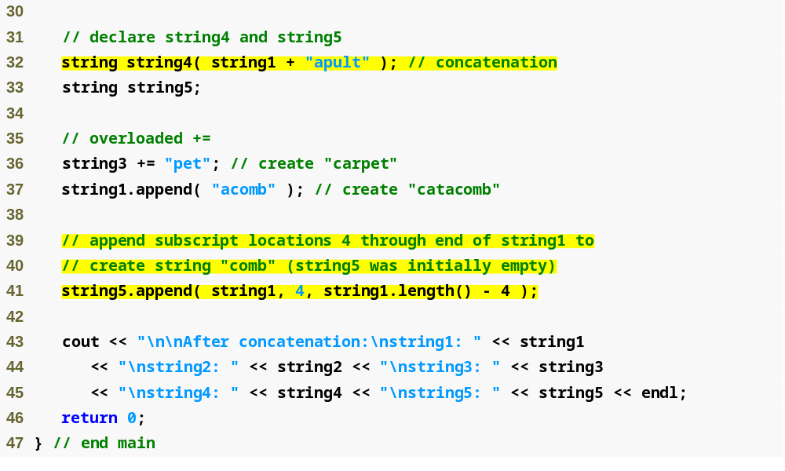
Initialize string4 to the result of concatenating string1 and "apult" using the addition operator +
Outline
Concatenate string3 and "pet" using the addition assignment operator +=
Fig18_01.cpp
(2 of 3)
Concatenate string1 and "acomb"
Append the string "comb" (the characters from subscript 4 to the end of string1) to empty string string5

Slide 16
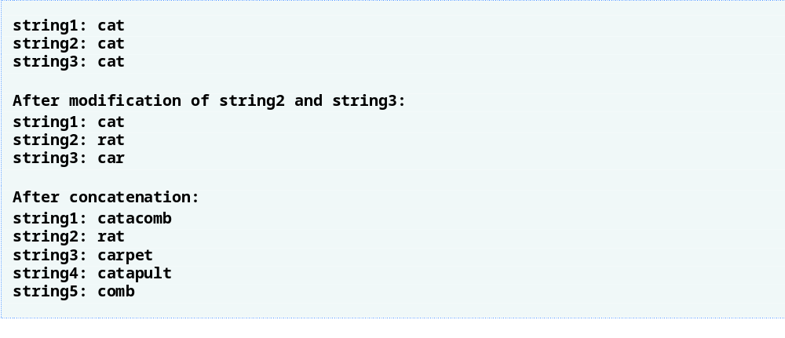
Outline
Fig18_01.cpp
(3 of 3)

Slide 17
Common Programming Error 18.2
Accessing a string subscript outside the bounds of the string using function at is a logic error that causes an out_of_range exception.

Slide 18
Common Programming Error 18.3
Accessing an element beyond the size of the string using the subscript operator is an unreported logic error.

Slide 19
18.3 Comparing strings
Overloaded comparison operators
  Operators ==, !=, <, >, <=, >= are overloaded for strings
    All return bool values
Member function compare
  Compares the values of two strings
    Returns 0 if the strings are equivalent
    Returns positive number if the current string is lexicographically greater than the argument string
    Returns negative number if the current string is lexicographically less than the argument string

Slide 20
18.3 Comparing strings (Cont.)
Member function compare (Cont.)
  Overloaded versions
    With five arguments
      First two arguments specify starting subscript and length in the current string
      Third argument specifies the comparison string
      Last two arguments specify starting subscript and length in the comparison string
    With three arguments
      First two arguments specify starting subscript and length in the current string
      Third argument specifies the comparison string

Slide 21
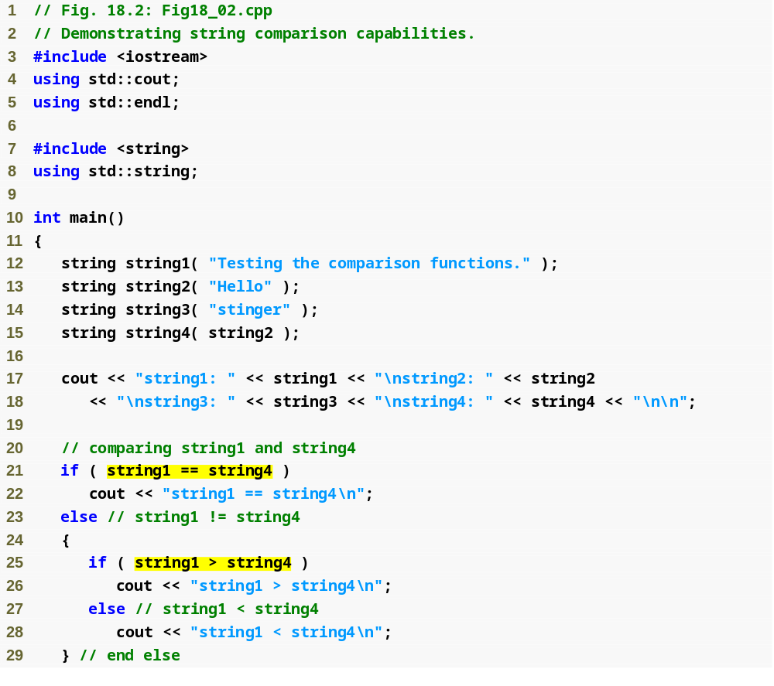
Outline
Fig18_02.cpp
(1 of 4)
Test string1 against string4 for equality using the overloaded equality operator
Test string1 against string4 using the overloaded greater-than operator

Slide 22
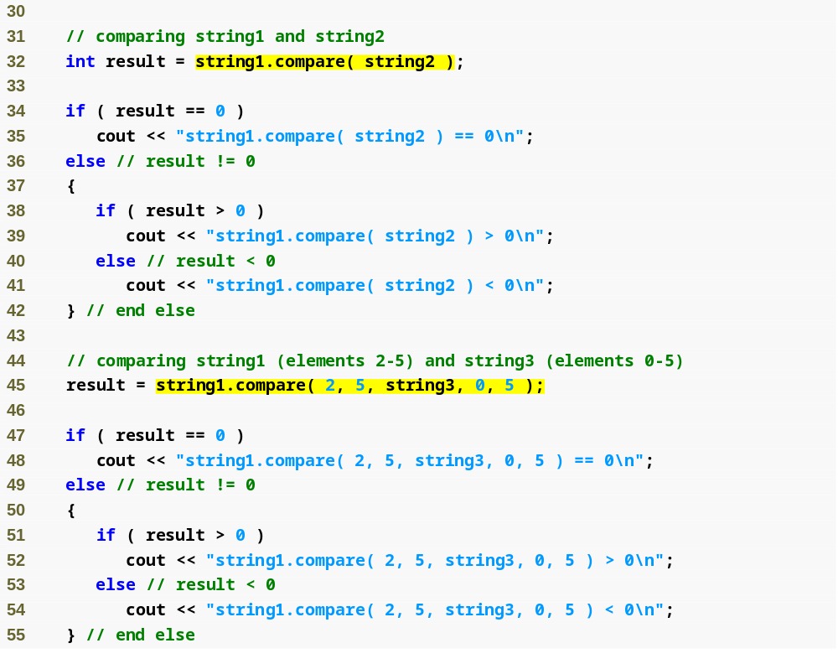
Outline
Compare string1 to string2
Fig18_02.cpp
(2 of 4)
Compare "sting" (from string1) to "sting" (from string3)

Slide 23
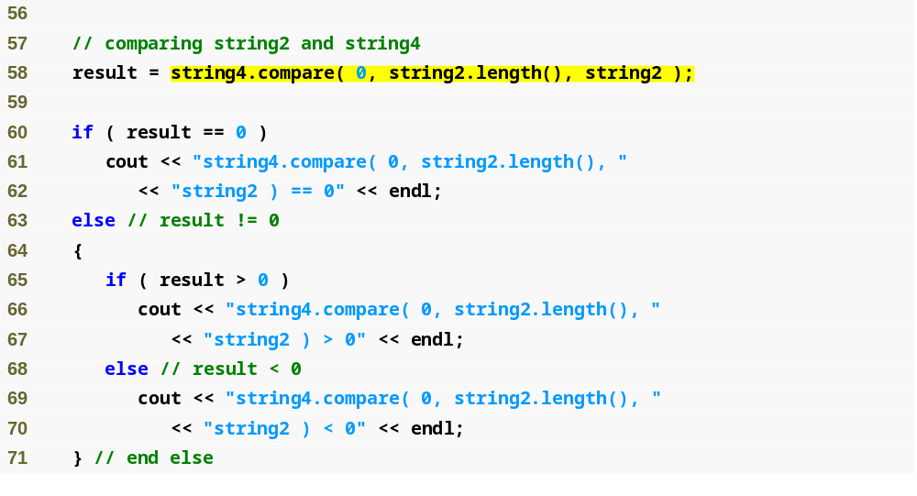
Outline
Compare "Hello" (from string4) to string2
Fig18_02.cpp
(3 of 4)

Slide 24
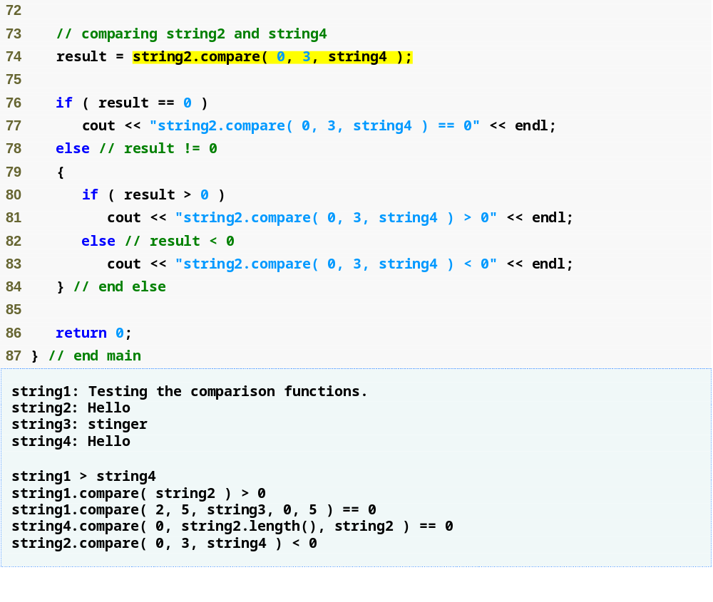
Outline
Compare "Hel" (from string2) to string4
Fig18_02.cpp
(4 of 4)

Slide 25
18.4 Substrings
Member function substr
  Retrieves a substring from a string
    Returns a new string object copied from the source string
  First argument
    Specifies beginning subscript of desired substring
  Second argument
    Specifies length of desired substring

Slide 26
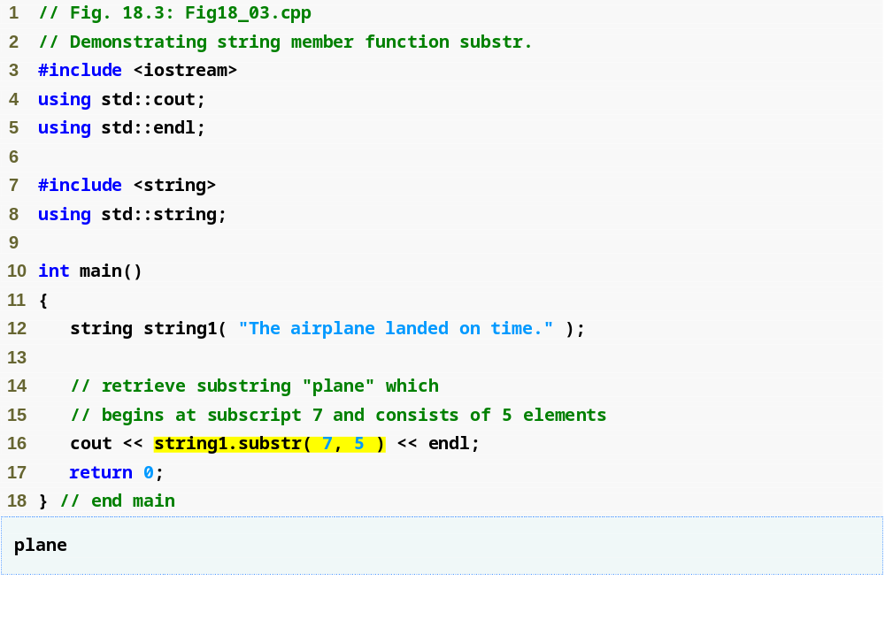
Outline
Fig18_03.cpp
(1 of 1)
Retrieve a substring from string1

Slide 27
18.5 Swapping strings
Member function swap
  Swaps contents of the current string and the argument string
  Useful for implementing programs that sort strings

Slide 28
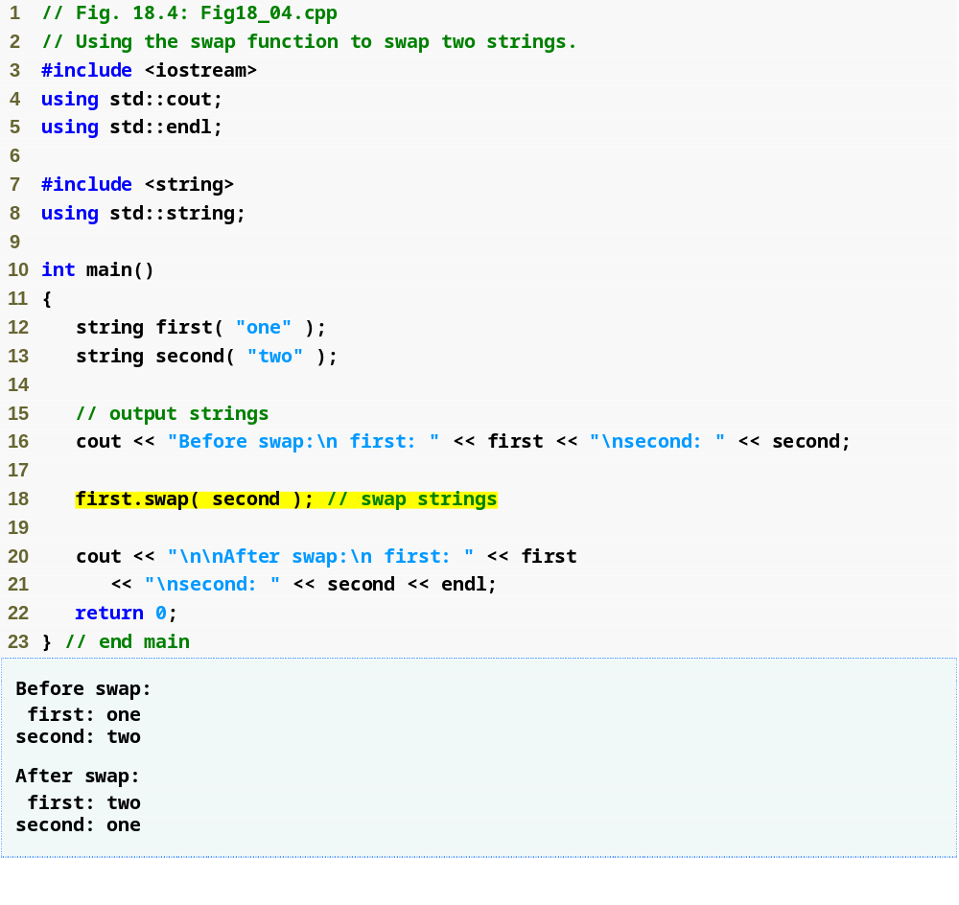
Outline
Fig18_04.cpp
(1 of 1)
Swap the values of first and second

Slide 29
18.6 string Characteristics
Characteristics of strings
  Capacity
    Number of characters that can be stored without allocating more memory
      Must be at least equal to the size, can be greater
      Depends on the implementation
    Returned by member function capacity
  Maximum size
    Largest possible size a string can have
      If exceeded, a length_error exception is thrown
    Returned by member function max_size

Slide 30
18.6 string Characteristics (Cont.)
Member function empty
  Returns true if the string is empty
Member function resize
  Changes the length of the current string
    Additional elements are set to null characters

Slide 31
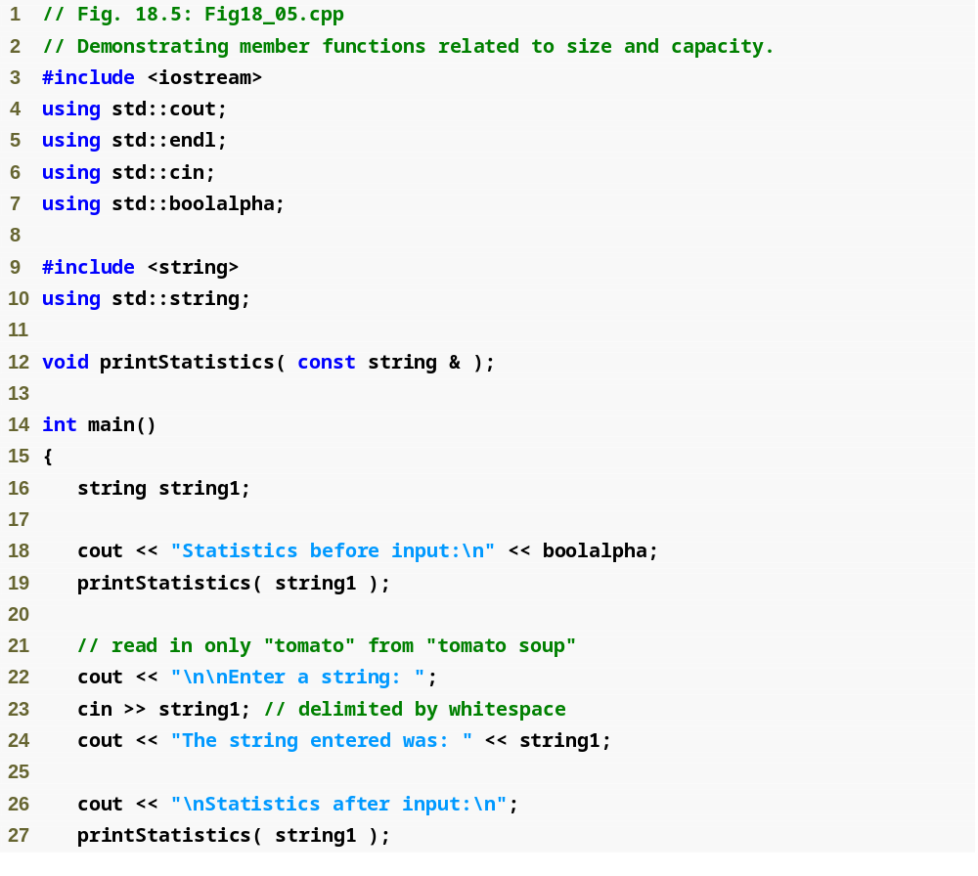
Outline
Fig18_05.cpp
(1 of 4)

Slide 32
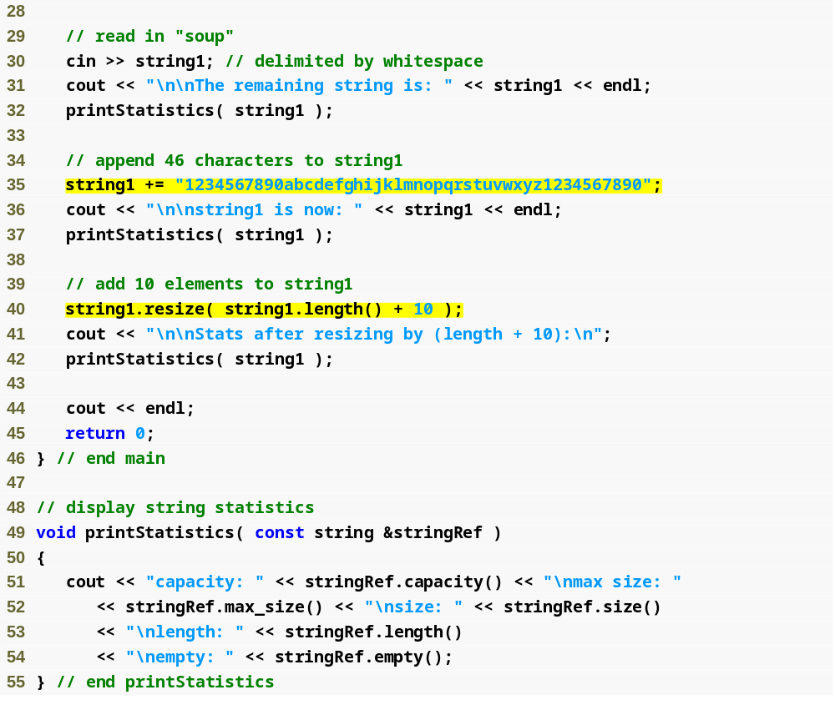
Outline
Use the overloaded += operator to concatenate a 46-character-long string to string1
Fig18_05.cpp
(2 of 4)
Increase the length of string1 by 10 characters
Output the capacity, maximum size, size, length and whether the string is empty

Slide 33
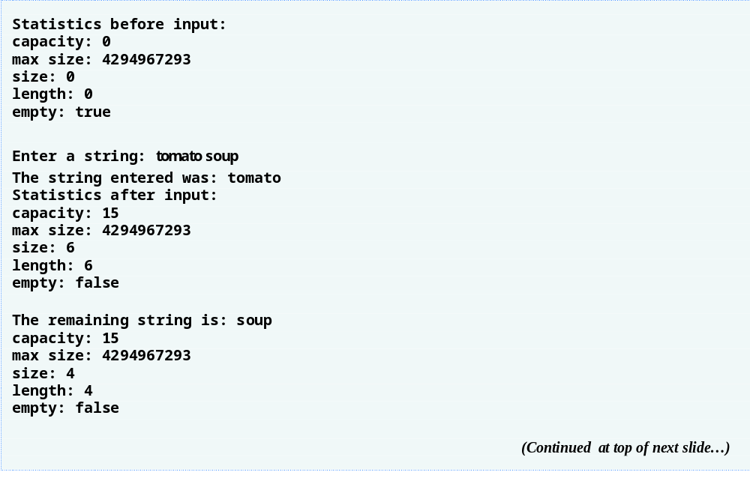
Outline
Fig18_05.cpp
(3 of 4)

Slide 34
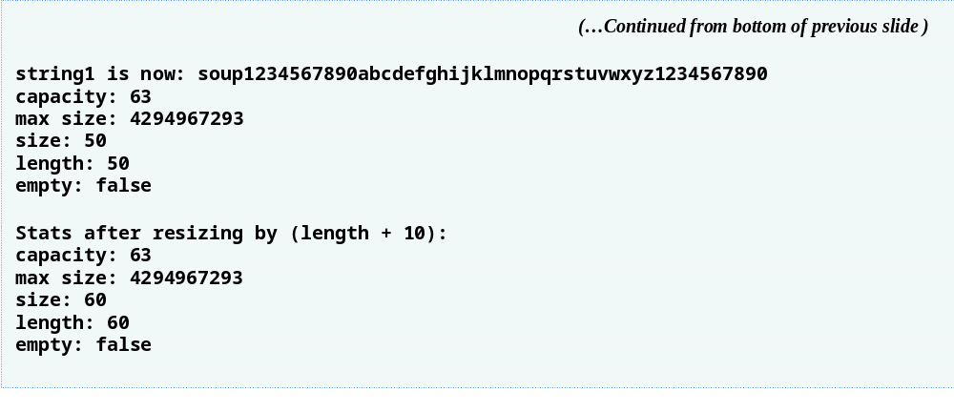
Outline
Fig18_05.cpp
(4 of 4)

Slide 35
Performance Tip 18.1
To minimize the number of times memory is allocated and deallocated, some string class implementations provide a default capacity above and beyond the length of the string.

Slide 36
18.7 Finding Strings and Characters in a string
Member function find
  Attempts to find specified string in the current string
    Returns starting location of the string if found
    Returns the value string::npos otherwise
      All string find-related functions return this const static value to indicate the target was not found
Member function rfind
  Searches current string backward (right-to-left) for the specified string
    If the string is found, its subscript location is returned

Slide 37
18.7 Finding Strings and Characters in a string (Cont.)
Member function find_first_of
  Locates first occurrence in the current string of any character in the specified string
Member function find_last_of
  Locates last occurrence in the current string of any character in the specified string
Member function find_first_not_of
  Locates first occurrence in the current string of any character not contained in the specified string

Slide 38
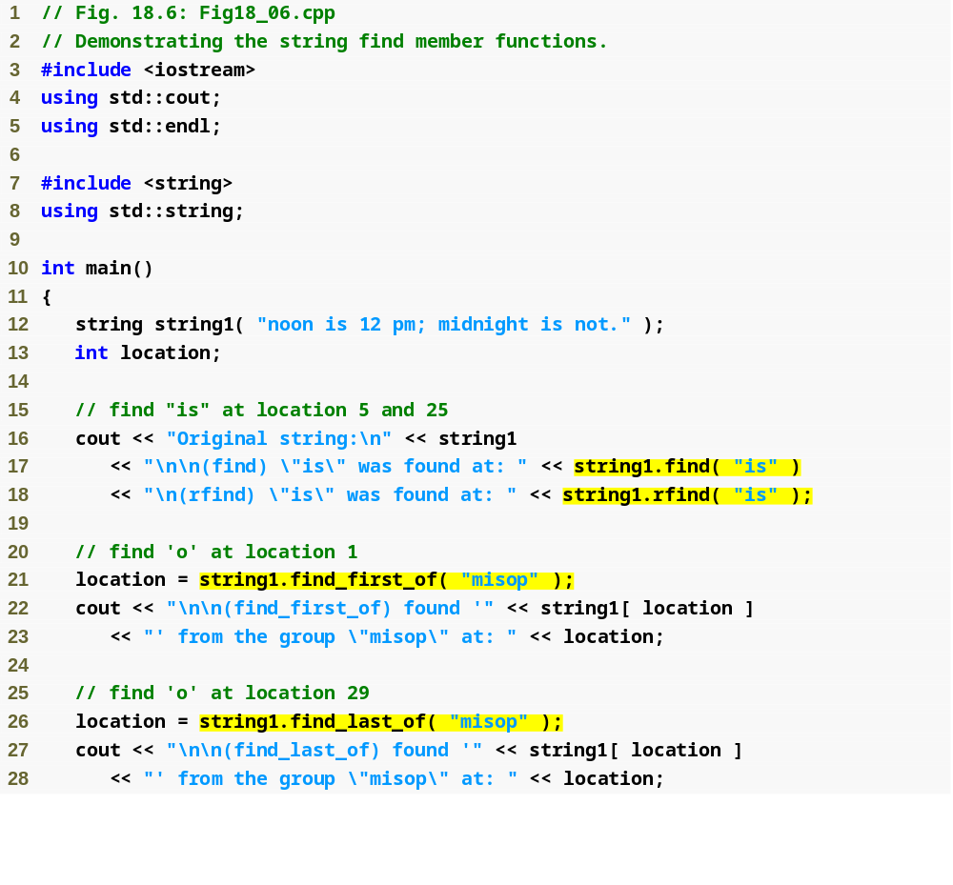
Outline
Fig18_06.cpp
(1 of 3)
Attempt to find "is" in string1 using function find
Search string1 backward for "is"
Locate the first occurrence in string1 of any character in "misop"
Find the last occurrence in string1 of any character in "misop"

Slide 39
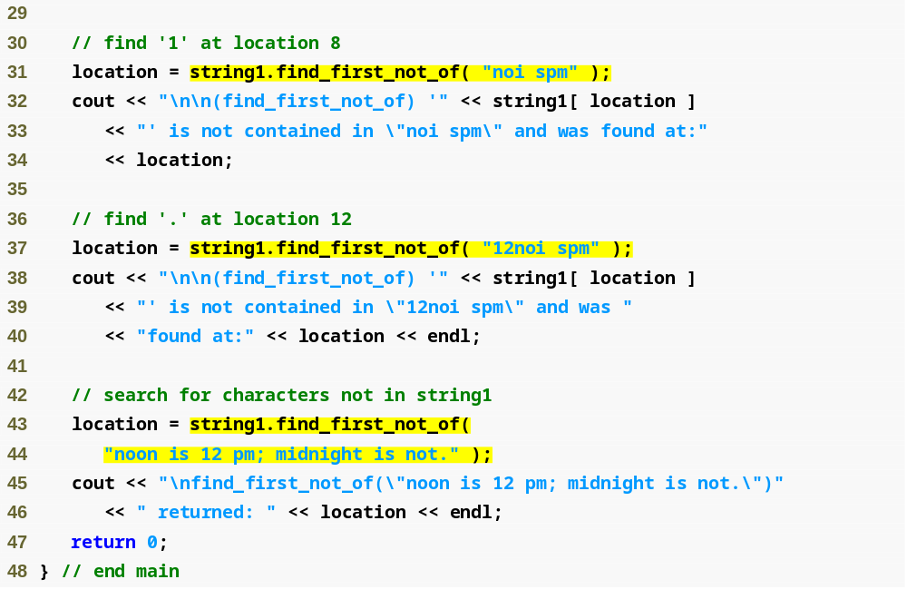
Outline
Find the first character in string1 not contained in the string argument
Fig18_06.cpp
(2 of 3)
string1 contains only characters specified in the string argument, so string::npos is returned

Slide 40
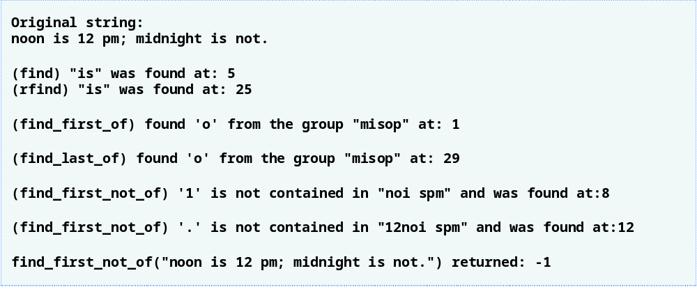
Outline
Fig18_06.cpp
(3 of 3)

Slide 41
18.8 Replacing Characters in a string
Member function erase
  One-argument version
    Erases everything from (and including) the specified character position to the end of the string
Member function replace
  Three-argument version
    Replaces characters in the range specified by the first two arguments with the specified string (third argument)
  Five-argument version
    Replaces characters in the range specified by the first two arguments with characters from the range in the specified string (third argument) specified by the last two arguments

Slide 42
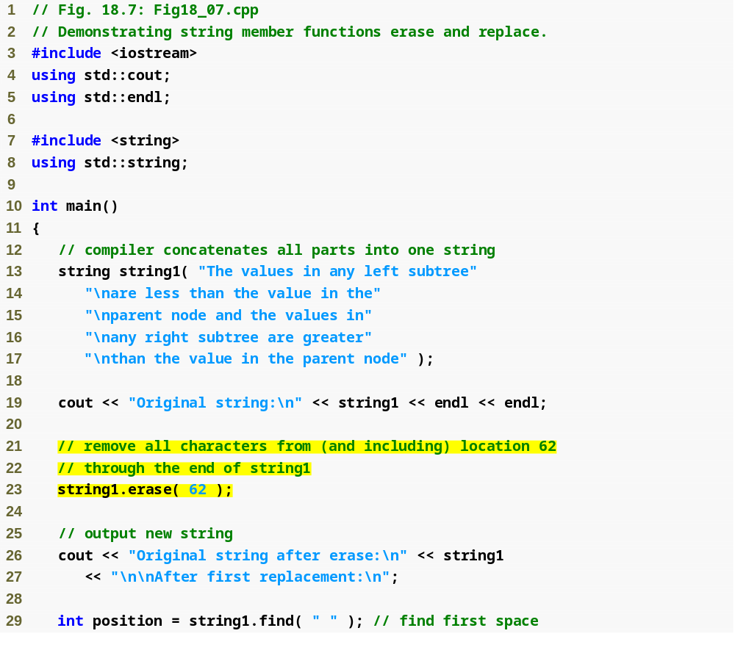
Outline
Fig18_07.cpp
(1 of 3)
Erase characters from string1 starting at position 62

Slide 43
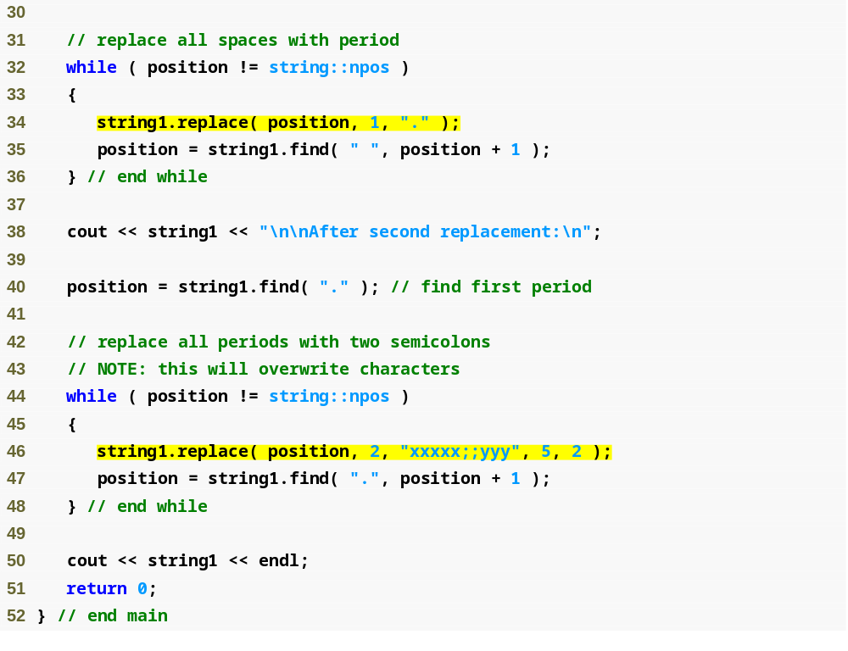
Locate each occurrence of the space character and replace it with a period
Outline
Fig18_07.cpp
(2 of 3)
Continue searching for the next space character at position + 1
Find every period and replace it and the neext character with two semicolons

Slide 44
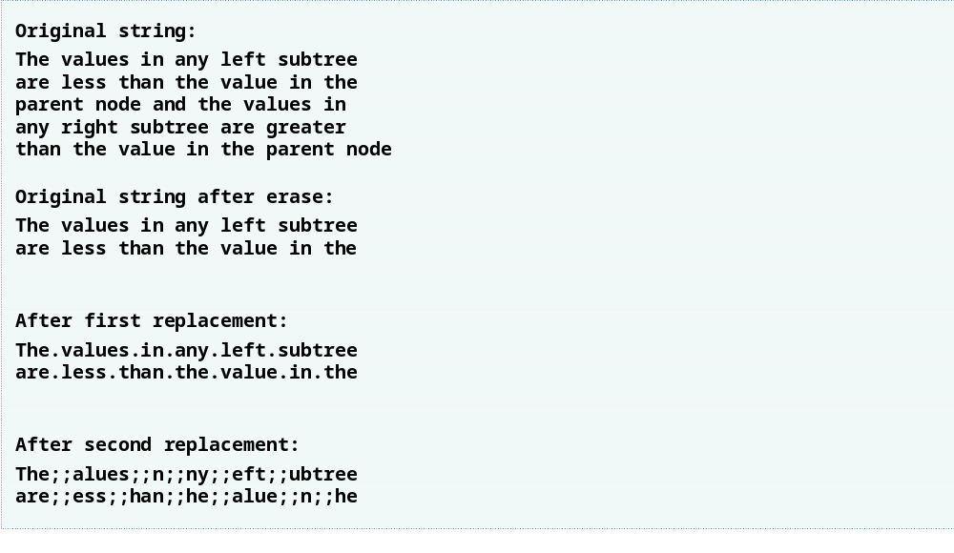
Outline
Fig18_07.cpp
(3 of 3)

Slide 45
18.9 Inserting Characters into a string
Member function insert
  For inserting characters into a string
    Two-argument version
      First argument specifies insertion location
      Second argument specifies string to insert
    Four-argument version
      First argument specifies insertion location
      Second argument specifies string to insert from
      Third and fourth arguments specify starting and last element in source string to be inserted
        Using string::npos causes the entire string to be inserted

Slide 46
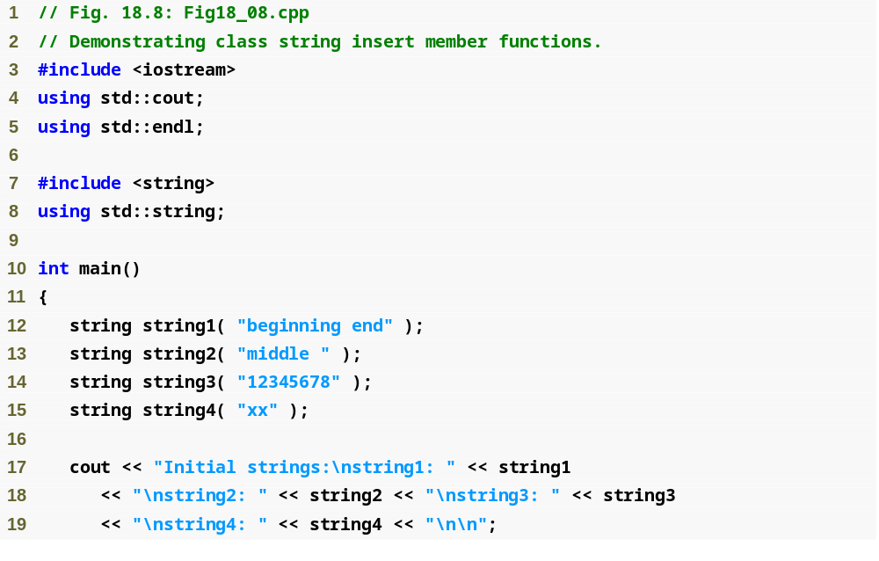
Outline
Fig18_08.cpp
(1 of 2)

Slide 47
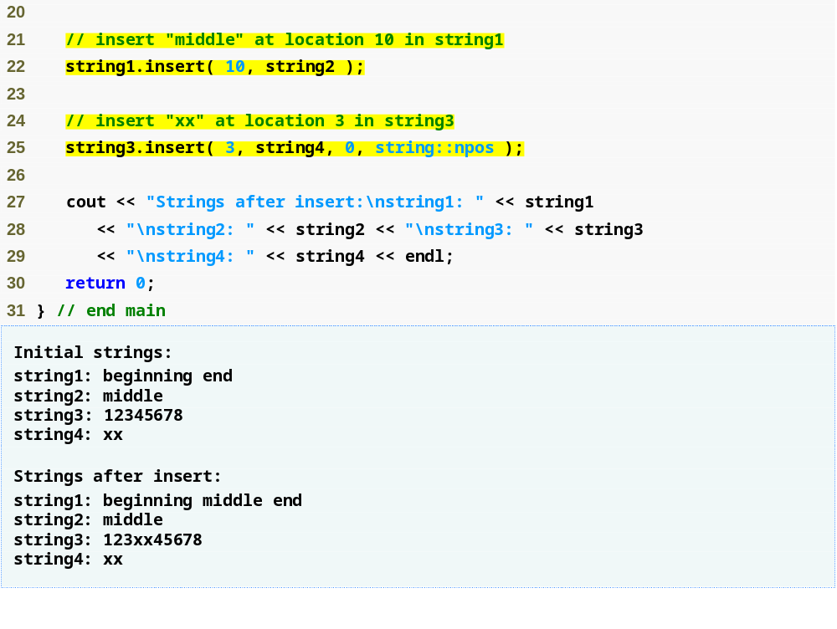
Outline
Insert string2’s contents before element 10 of string1
Fig18_08.cpp
(2 of 2)
Insert string4 before string3’s element 3

Slide 48
18.10 Conversion to C-Style Pointer-Based char * Strings
Member function copy
  Copies current string into the specified char array
    Must manually add terminating null character afterward
Member function c_str
  Returns a const char * containing a copy of the current string
    Automatically adds terminating null character
Member function data
  Returns non-null-terminated C-style character array
    If original string object is later modified, this pointer becomes invalid

Slide 49
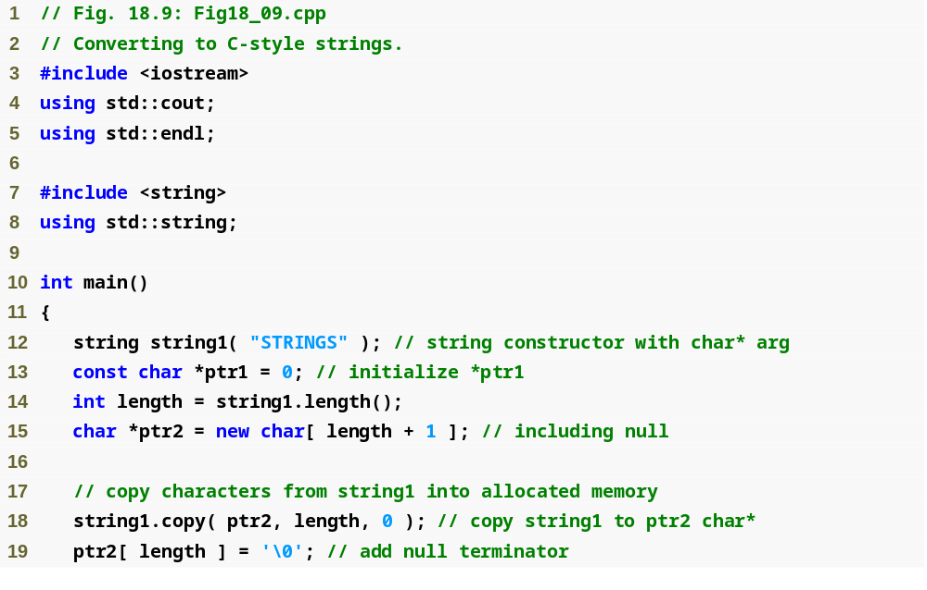
Outline
Fig18_09.cpp
(1 of 2)
Copy object string1 into the char array pointed to by ptr2
Manually place a terminating null character at the end of the array

Slide 50
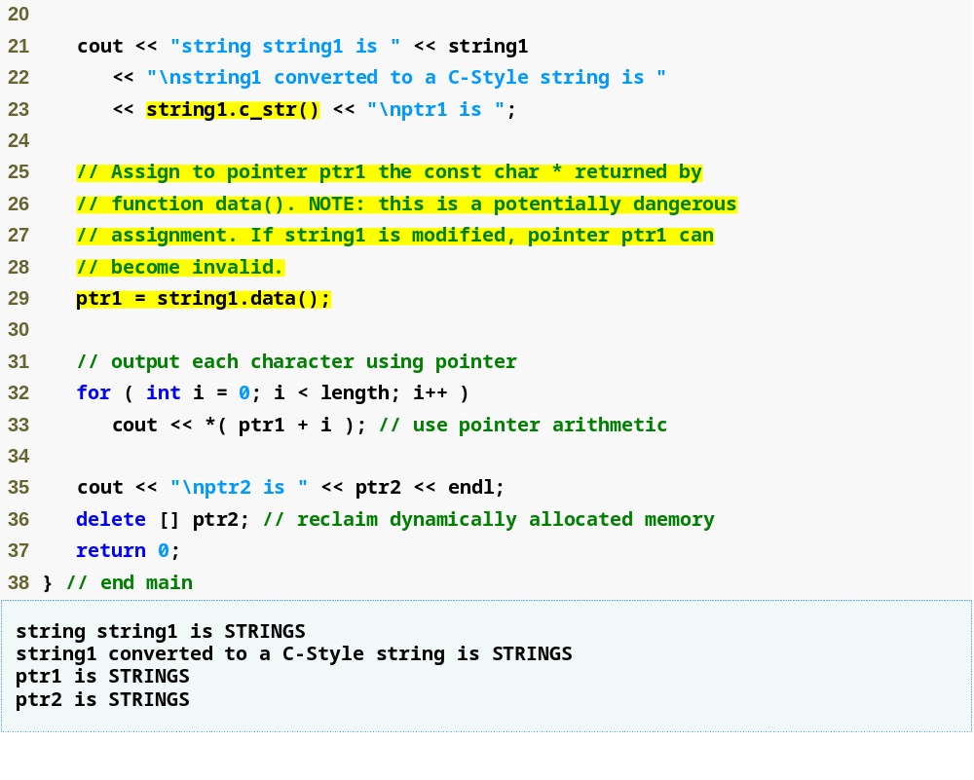
Outline
Output the null-terminated array pointed to by the const char * returned by member function c_str
Fig18_09.cpp
(2 of 2)
Assign the const char * ptr1 a pointer returned by member function data

Slide 51
Common Programming Error 18.4
Not terminating the character array returned by data with a null character can lead to execution-time errors.

Slide 52
Good Programming Practice 18.1
Whenever possible, use the more robust string class objects rather than C-style pointer-based strings.

Slide 53
18.11 Iterators
string iterators
  Provide access to individual characters
    Syntax similar to pointers
  string::iterator and string::const_iterator
    A const_iterator cannot modify the string
    string member function begin
      Returns iterator positioned at the beginning of the string
      Another version returns const_iterators for const strings
    string member function end
      Returns iterator (or const_iterator) positioned after the last element of the string

Slide 54
18.11 Iterators (Cont.)
string iterators (Cont.)
  Using iterators
    Dereference iterator to access individual characters
    Use operator ++ to advance iterator one position
  reverse_iterator and const_reverse_iterator
    Used for reverse traversal of strings (from the end toward the beginning)
    string member functions rend and rbegin
      Return reverse_iterators and const_reverse_iterators

Slide 55
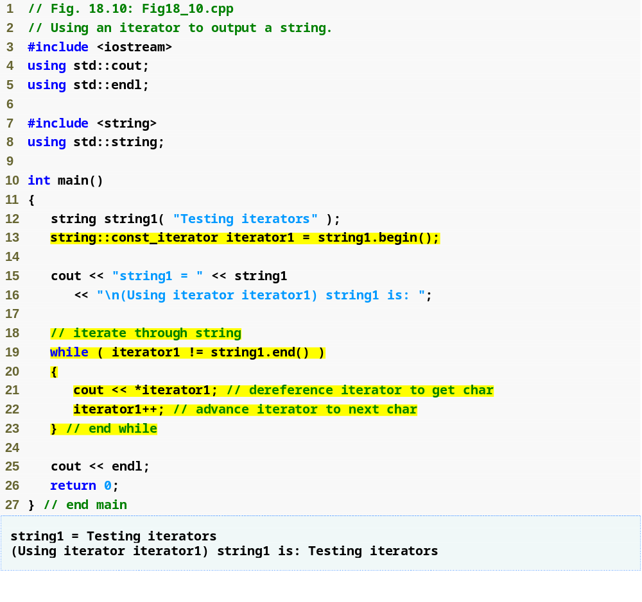
Outline
Fig18_10.cpp
(1 of 1)
const_iterator iterator1 is initialized to the beginning of string1
Use iterator iterator1 to “walk through” string1

Slide 56
Error-Prevention Tip 18.1
Use string member function at (rather than iterators) when you want the benefit of range checking.

Slide 57
Good Programming Practice 18.2
When the operations involving the iterator should not modify the data being processed, use a const_iterator. This is another example of employing the principle of least privilege.

Slide 58
18.12 String Stream Processing
String stream processing (a.k.a. in-memory I/O)
  Enables inputting from, and outputting to, strings in memory
  Class istringstream
    A typedef for basic_istringstream< char >
    Supports input from a string
      Provides same functionality as istream
  Class ostringstream
    A typedef for basic_ostringstream< char >
    Supports output to a string
      Provides same functionality as ostream
  Program must include <sstream> and <iostream>

Slide 59
18.12 String Stream Processing (Cont.)
Application of string stream processing
  Data validation
    Read an entire line from the input stream into a string
    Scrutinize and repair contents of the string
    Input from the string to program variables
  Preserving the screen image
    Data can be prepared in a string
      Mimicking the edited screen format
    The string could then be written to a disk file

Slide 60
18.12 String Stream Processing (Cont.)
ostringstream object
  Uses a string to store output data
    Member function str returns copy of that string
  Data can be appended to the string in memory by using stream insertion operator
istringstream object
  Inputs data from a string in memory to program variables
    Input works identically to input from files
      End of the string is interpreted as end-of-file
  Member function good returns true if any data remains

Slide 61
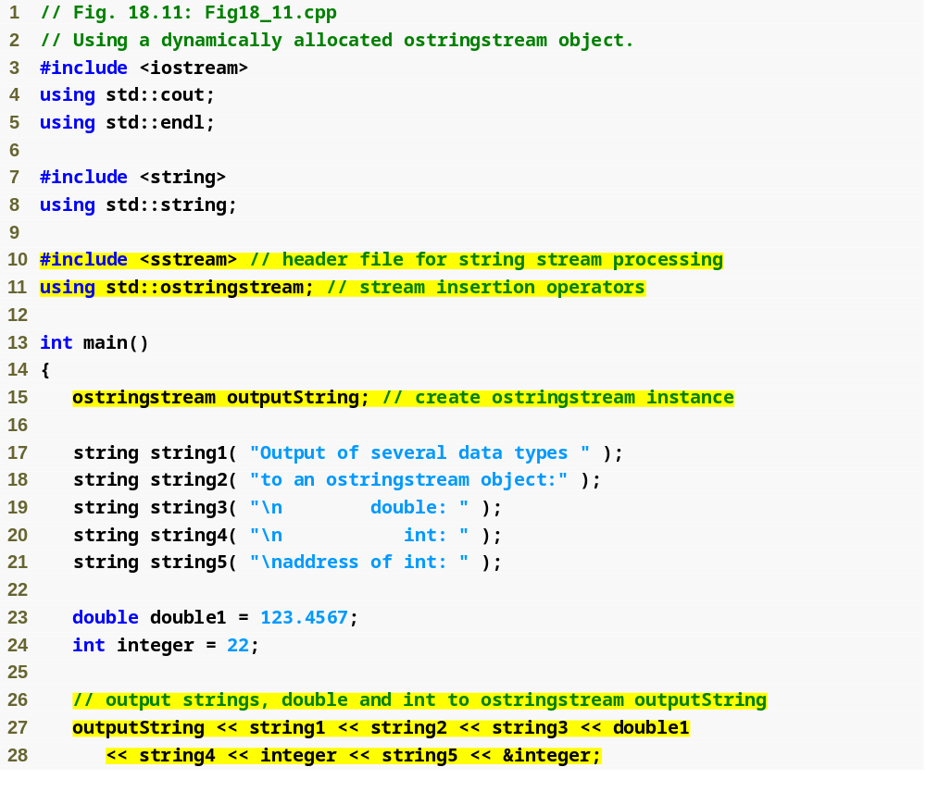
Outline
Fig18_11.cpp
(1 of 2)
Create ostringstream object outputString
Output a series of strings and numerical values to outputString

Slide 62
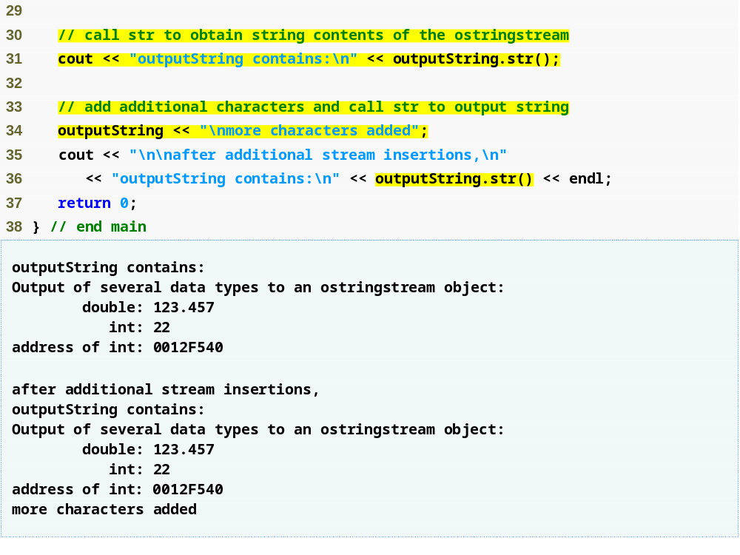
Outline
Display a copy of the string contained in outputString
Fig18_11.cpp
(2 of 2)
Append more data to the string in memory by issuing another stream insertion operation

Slide 63
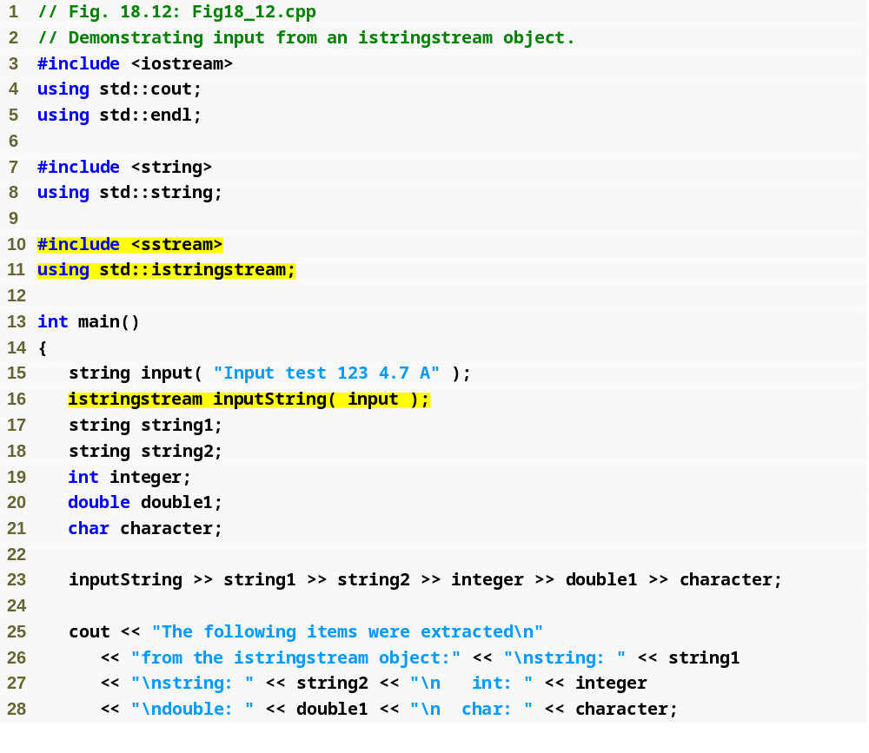
Outline
Fig18_12.cpp
(1 of 2)
Create istringstream inputString to contain the data in string input
Extract characters to program variables

Slide 64
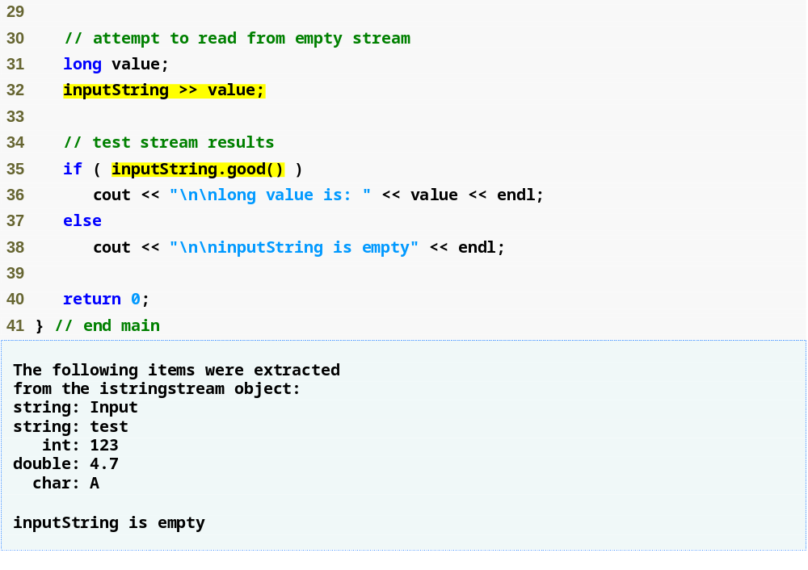
Outline
Test if any data remains
Fig.18_12.cpp
(2 of 2)

